Slide 1
Most Common Grading Issues
Fix these now or accept penalties

Slide 2
Table of Contents
1. How do I make a new Java 1.8 (aka Java 8) project?
2. How do I change Java 9 to Java 8?
Also in this section: How to tell if I’m using Java 9?
3. What do I need to remove?
4. How do I zip?

Slide 3
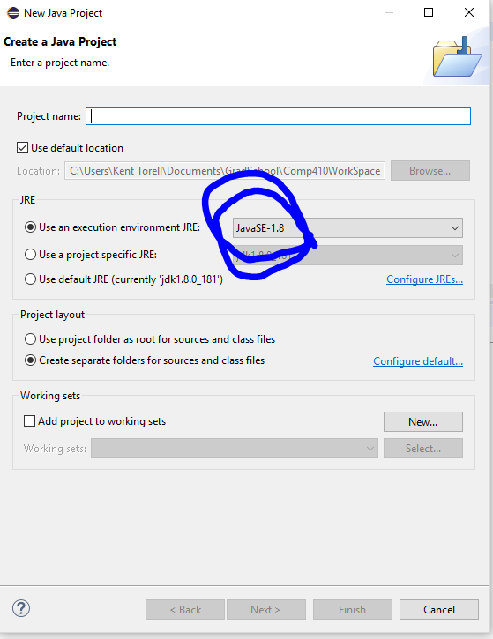
How do I make a new Java 8 project?
When creating a new java project change this box here:

Slide 4
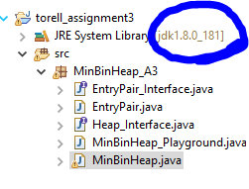
How to Change Java Versions
But first how to tell if I am using Java 9.
If this dialogue box says anything but 1.8._____ then you need to change it

Slide 5
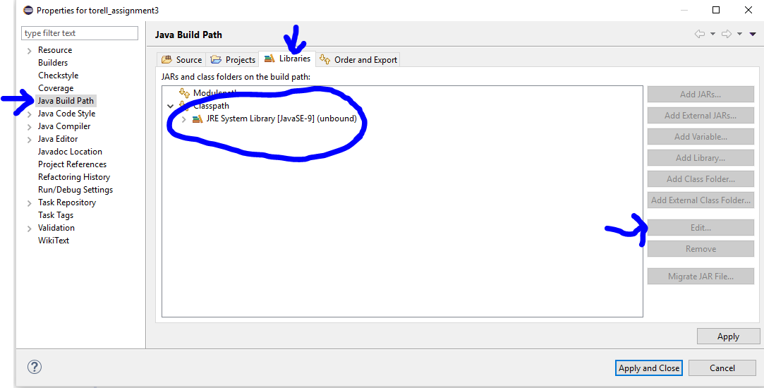
How to Change Java Versions
Right click the project → Properties → Java Build Path → Libraries → (if you see Modulepath and Classpath here you are using Java 9) Open “classpath” → Click Java 9 → Click “Edit”

Slide 6
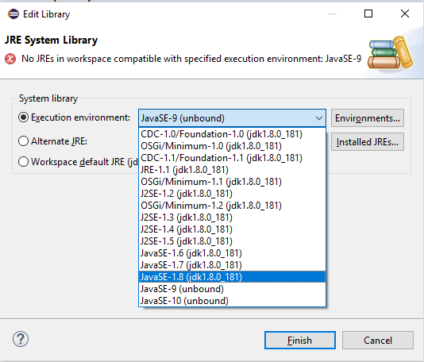
How to Change Java Versions
Make sure you change Execution environment to JavaSE-1.8, finish, and apply

Slide 7
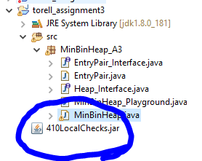
What do I need to remove?
Leaving RunTests is ok, but if you have the following in your project (most don’t) you need to remove it

Slide 8
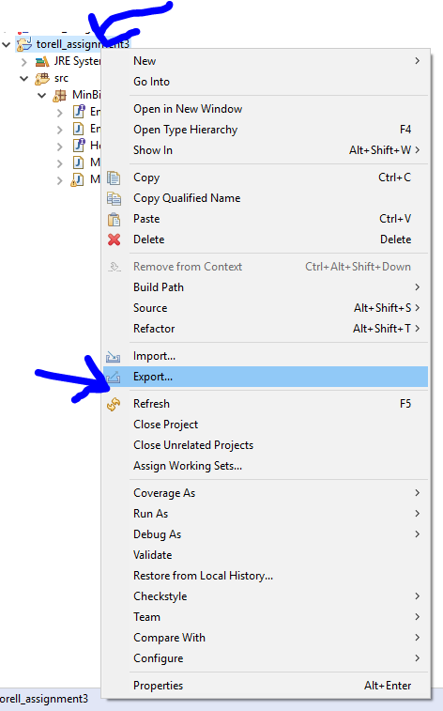
How do I zip?
DO NOT SUBMIT A .JAR FILE
Right click the PROJECT → Export

Slide 9
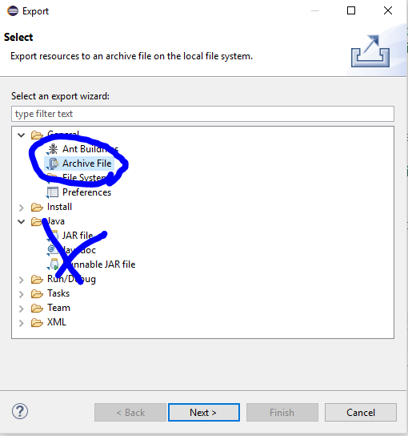
How do I zip?
Click Archive file under the General Tab → Next

Slide 10
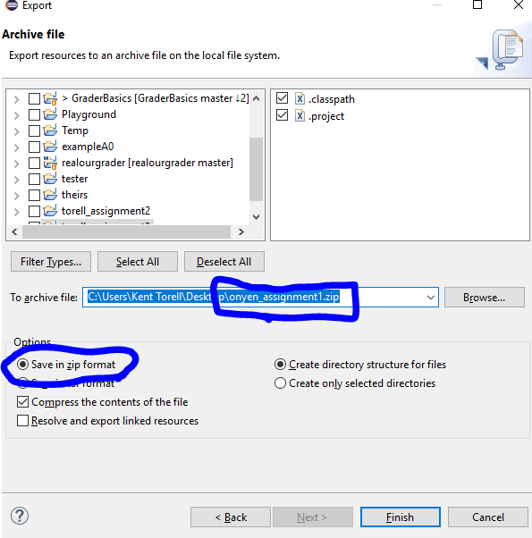
How do I zip?
Save in Zip format and correctly name your file (onyen_assignment1.zip without capitalization)

